Slide 1
E-Commerce Cart System using C Language
Project-Based Learning (PBL) Report
Programming Language: C Data Structures:
Hash Table Linked List Stack

Slide 2

1. INTRODUCTION
Online shopping has become essential in modern retail.
E-commerce platforms require efficient cart management systems.
This project implements a basic E-Commerce Cart System in C language to demonstrate practical use of data structures.
The system uses:
Hash Table for product storage Linked List for cart management Stack for undo functionality

Slide 3
2. ABSTRACT
This project aims to design and implement an E-Commerce Cart System using C language. The system demonstrates the practical application of three fundamental data structures: Hash Table for efficient product lookup, Linked List for dynamic cart item management, and Stack for implementing undo functionality. The project focuses on core data structure concepts without using databases or web technologies.

Slide 4
3. PROJECT APPROACH
Create a structured approach with 4 key points:
01 02
Hash Table Implementation
Store product details (ID, name, price) using hash function for O(1) lookup.
Linked List for Cart
Dynamically manage cart items with add/remove operations.
03
04
Stack for Undo
Store removed items to enable undo functionality using LIFO principle.
Modular C Functions
Separate functions for each operation (add, remove, display, checkout).

Slide 5
4. CHALLENGES / ROADBLOCKS
1
2
Manual Hash Table Implementation
Implementing hash function and collision handling in C without built-in libraries.
Dynamic Memory Management
Proper allocation and deallocation of memory for linked list nodes and hash table entries to avoid memory leaks.
3
4
Pointer Manipulation
Managing pointers correctly for linked list traversal and stack operations.
Edge Case Handling
Handling empty cart, duplicate products, invalid inputs, and undo on empty stack.

Slide 6
5. PROJECT OUTCOMES
01
02
03
Implemented Functional System
Successfully implemented a functional E-Commerce Cart System in C language.
Data Structure Understanding
Demonstrated practical understanding of Hash Table, Linked List, and Stack data structures.
Proficiency in C Operations
Gained proficiency in dynamic memory management and pointer operations in C.
04
05
Developed Modular Functions
Developed modular and reusable C functions for cart operations.
Enhanced Skills
Enhanced problem-solving and debugging skills.

Slide 7
6. PROBLEM STATEMENT
To design and implement an E-Commerce Cart System using C language that efficiently manages shopping cart operations. The system must allow users to:
1 2
Add products to cart Remove products from cart
3
4
Undo last removed product
Display all cart items
5
6
Calculate total price with discount Simulate checkout
The system must use Hash Table for product storage, Linked List for cart management, and Stack for undo functionality, demonstrating practical application of data structures in C.

Slide 8
7. RELATED WORK
Real-world e-commerce platforms like Amazon, Flipkart, and eBay use advanced backend systems for cart management. These systems handle millions of transactions using optimized databases and distributed systems. However, this project is a simplified academic implementation focusing on understanding core data structures in C language. It demonstrates fundamental concepts without using databases, web frameworks, or external libraries.

Slide 9
8. SYSTEM WORKFLOW
01
User selects product ID
User selects product ID from available products.
02
Search product details
System searches product details in Hash Table using product ID.
03
Add product to cart
Product is added to cart (Linked List).
05
Push to Stack for undo
Removed item is pushed to Stack for undo.
04
Remove items from cart
User can remove items from cart.
06
Undo last removal
User can undo last removal by popping from Stack.
07
Apply discount
Discount is applied to total
08
Checkout displays final bill
Checkout displays final bill

Slide 10
9. FEATURES PROVIDED
1
2
3
Add Product to Cart
Add selected products with quantity.
Remove Product from Cart
Remove items from cart.
Undo Last Removed Product
Restore last removed item using Stack.
4
5
6
Display Cart Items
Show all items in cart with details.
Apply Discount
Calculate and apply discount on total.
Checkout Simulation
Display final bill with total amount.
7
Search Products
Quick search using Hash Table.

Slide 11
10. PROPOSED METHODOLOGY
Explain the implementation approach:
01 02 03
Hash Table Design
Create hash table with array of buckets, implement hash function (product_id % table_size), handle collisions using chaining.
Linked List for Cart
Create node structure with product details, implement add/remove operations.
Stack for Undo
Create stack structure, push removed items, pop for undo.
04
05
Main Functions
Implement separate functions: addToCart(), removeFromCart(), undoRemove(), displayCart(), calculateTotal(), checkout().
Input Validation
Validate all user inputs and handle edge cases.

Slide 12
11. OUTPUT / RESULT
1
2
3
Product Display
System displays all available products with ID, name, and price.
Cart Operations
Successfully adds/removes items from cart with real- time updates.
Undo Functionality
Undo operation correctly restores last removed item.
4
5
6
Cart Display
Shows all items in cart with quantity and individual prices.
Discount Calculation
Applies discount percentage and shows discounted total.
Final Bill
Displays itemized bill with subtotal, discount, and final amount.

Slide 13

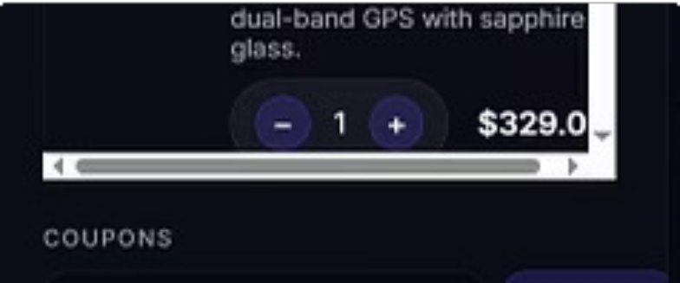
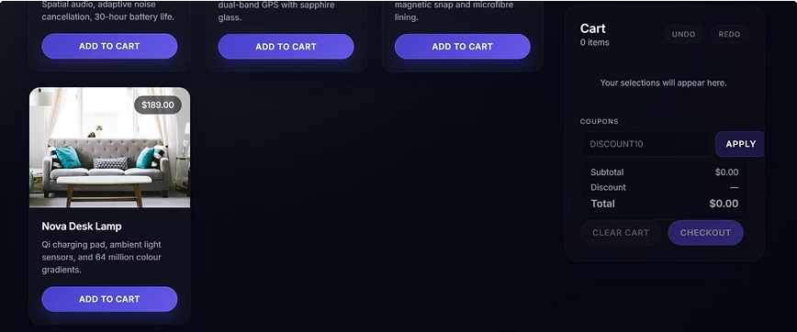
12. PROJECT PHOTOS
Below are images showcasing the E-Commerce Cart System interface, demonstrating its functionality from product listing to checkout, including cart management features.

Slide 14
13. CONCLUSION
This project successfully demonstrates the practical application of fundamental data structures (Hash Table, Linked List, Stack) in implementing a real-world e-commerce cart system using C language.
1 2
3
Efficient Product Lookup
Showcased using Hash Tables (O(1) average case) for quick product retrieval.
Dynamic Cart Management
Achieved through the use of Linked Lists for flexible item addition and removal.
Intuitive Undo Functionality
Implemented using Stacks to easily revert the last removed item.
Through this project, we have gained deep understanding of data structure concepts, memory management, and modular programming in C. The system is fully functional, handles edge cases, and is suitable for academic learning and viva examination. This project reinforces the importance of choosing appropriate data structures for solving real-world problems efficiently.

